Slide 1
Ch 1. What’s Vis, and Why Do It?
1

Slide 2
Definition of data visualization
Creating images that convey salient information about underlying data and processes
Computers are good in quickly processing large amounts of data.
Humans are good in making decisions based on their expertise.
Humans can visually process information in parallel. Visuals are intuitive.

Slide 3
Goals
Obtain insight into the given data
1) Answering specific questions:
• quantitative: What are the data values and their distribution?
• qualitative: Is this feature occurring in the data?
2) Discovering the unknown: What is in the data set?

Slide 4
Visualization is the process of extracting salient features from sets of data and displaying the features in an intuitive and expressive way.
Find and develop step-wise methods for
– feature extracting
– feature display

Slide 5
Visualization is the process of extracting salient features from sets of data and displaying the features in an intuitive and expressive way.
Application-specific
Anything that can be relevant to the user
Characteristics and properties of data

Slide 6
Visualization is the process of extracting salient features from sets of data and displaying the features in an intuitive and expressive way.
Collected data using
– measurements
– simulations
Spatial data -> Scientific Visualization
Non-spatial data -> Information Visualization

Slide 7
Visualization is the process of extracting salient features from sets of data and displaying the features in an intuitive and expressive way.
Render on a computer screen
Allow for interaction
Animations
Computer graphics

Slide 8
Visualization is the process of extracting salient features from sets of data and displaying the features in an intuitive and expressive way.
The user must be able to understand the produced images without major training
Misleading visualizations are to be avoided
The extracted feature needs to be visually documented

Slide 9


Why have a human in the loop?
Computer-based visualization systems provide visual representations of datasets designed to help people carry out tasks more effectively.
Visualization is suitable when there is a need to augment human capabilities rather than replace people with computational decision-making methods.
don’t need vis when fully automatic solution exists and is trusted
many analysis problems ill-specified
don’t know exactly what questions to ask in advance
possibilities
long-term use for end users (e.g. exploratory analysis of scientific data)
presentation of known results
stepping stone to better understanding of requirements before developing models
help developers of automatic solution refine/debug, determine parameters
help end users of automatic solutions verify, build trust
9

Slide 10


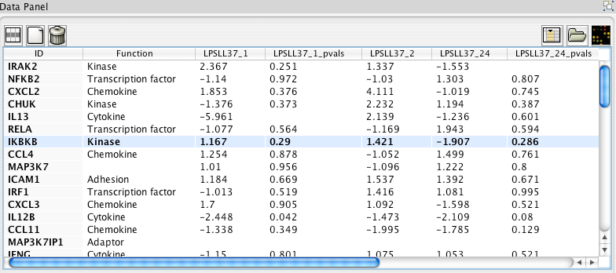
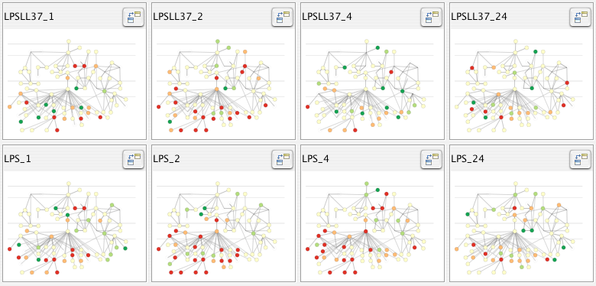
Why use an external representation?
Computer-based visualization systems provide visual representations of datasets designed to help people carry out tasks more effectively.
external representation: replace cognition with perception
[Cerebral: Visualizing Multiple Experimental Conditions on a Graph with Biological Context. Barsky, Munzner, Gardy, and Kincaid. IEEE TVCG (Proc. InfoVis) 14(6):1253-1260, 2008.]
10

Slide 11

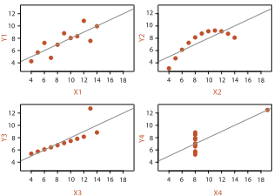
Why represent all the data?
Computer-based visualization systems provide visual representations of datasets designed to help people carry out tasks more effectively.
summaries lose information, details matter
confirm expected and find unexpected patterns
assess validity of statistical model
Anscombe’s Quartet
Identical statistics
x mean | 9
x variance | 10
y mean | 7.5
y variance | 3.75
x/y correlation | 0.816
https://www.youtube.com/watch?v=DbJyPELmhJc
Same Stats, Different Graphs
11

Slide 12


Why focus on tasks and effectiveness?
Computer-based visualization systems provide visual representations of datasets designed to help people carry out tasks more effectively.
tasks serve as constraint on design (as does data)
idioms do not serve all tasks equally!
challenge: recast tasks from domain-specific vocabulary to abstract forms
what counts as effective?
novel: enable entirely new kinds of analysis
faster: speed up existing workflows
12

Slide 13
Why are there resource limitations?
Vis designers must take into account three very different kinds of resource limitations: those of computers, of humans, and of displays.
computational limits
processing time
system memory
human limits
human attention and memory
display limits
pixels are precious resource, the most constrained resource
information density: ratio of space used to encode info vs unused whitespace
tradeoff between clutter and wasting space, find sweet spot between dense and sparse
13

Slide 14

Analysis: What, why, and how
what is shown?
data abstraction
why is the user looking at it?
task abstraction
how is it shown?
idiom: visual encoding and interaction
abstract vocabulary avoids domain-specific terms
translation process iterative, tricky
what-why-how analysis framework as scaffold to think systematically about design space
14

Slide 15
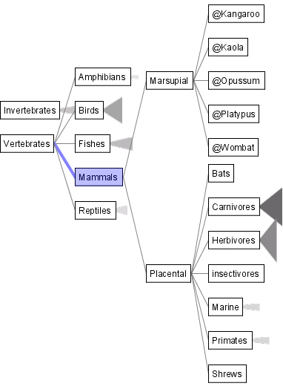
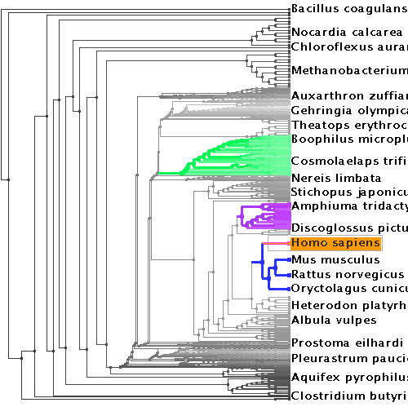
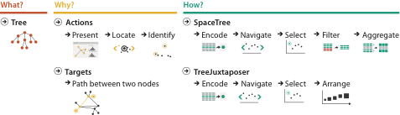

Why analyze?
SpaceTree
TreeJuxtaposer
imposes structure on huge design space
scaffold to help you think systematically about choices
analyzing existing as stepping stone to designing new
most possibilities ineffective for particular task/data combination
[SpaceTree: Supporting Exploration in Large Node Link Tree, Design Evolution and Empirical Evaluation. Grosjean, Plaisant, and Bederson. Proc. InfoVis 2002, p 57–64.]
[TreeJuxtaposer: Scalable Tree Comparison Using Focus+Context With Guaranteed Visibility. ACM Trans. on Graphics (Proc. SIGGRAPH) 22:453– 462, 2003.]
15

Slide 16
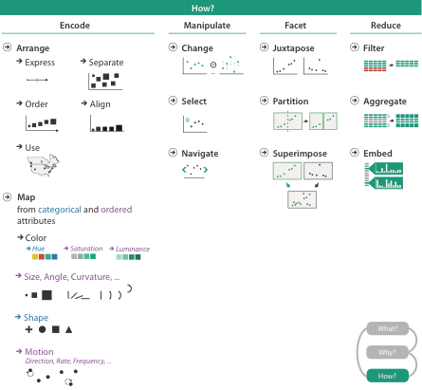

16

Slide 17
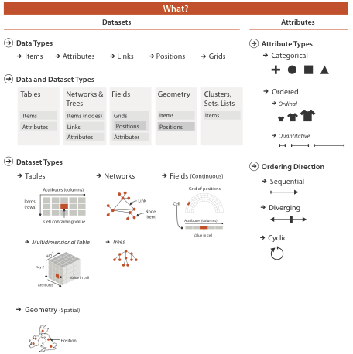
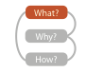
VAD Ch 2: Data Abstraction
[VAD Fig 2.1]
17

Slide 18
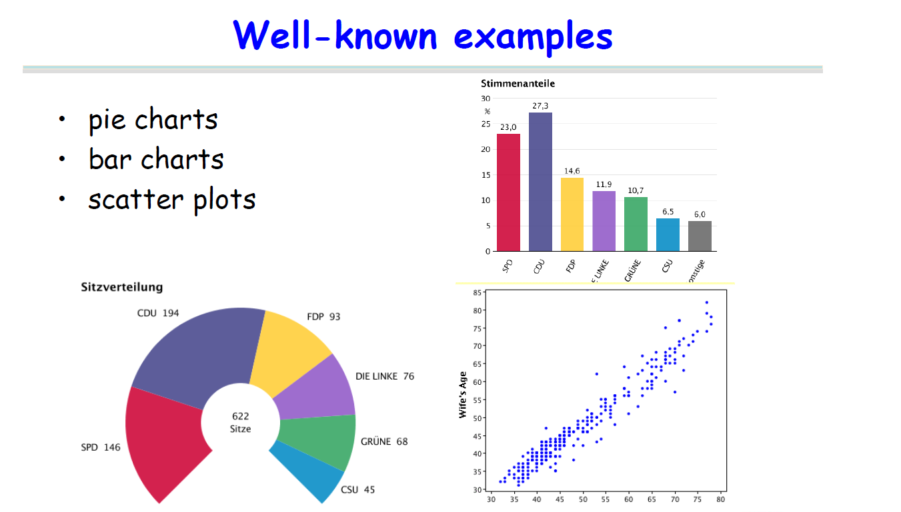

Slide 19
Ch 2. What: Data Abstraction
19

Slide 20
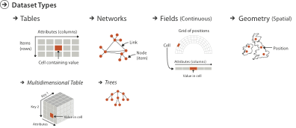
Three major datatypes
Spatial
visualization vs computer graphics
geometry is design decision
20

Slide 21
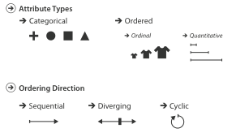
Attribute types
21

Slide 22
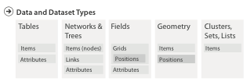

Dataset and data types
22

Slide 23

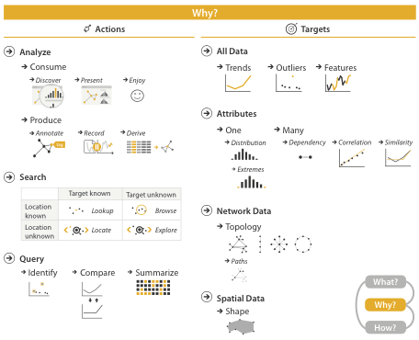
VAD Ch 3: Task Abstraction
{action, target} pairs
discover distribution
compare trends
locate outliers
browse topology
[VAD Fig 3.1]
23

Slide 24
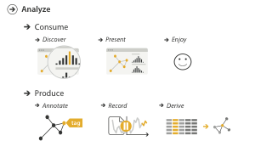
High-level actions: Analyze
consume
discover vs present
classic split
aka explore vs explain
enjoy
newcomer
aka casual, social
produce
annotate, record
derive
crucial design choice
24

Slide 25
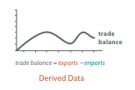

Derive
don’t just draw what you’re given!
decide what the right thing to show is
create it with a series of transformations from the original dataset
draw that
one of the four major strategies for handling complexity
25

Slide 26
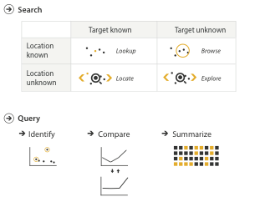
Actions: Mid-level search, low-level query
what does user know?
target, location
how much of the data matters?
one, some, all
independent choices, mix & match
analyze, query, search
26

Slide 27
Targets
27

Slide 28
Analysis example: Compare idioms
SpaceTree
TreeJuxtaposer
[SpaceTree: Supporting Exploration in Large Node Link Tree, Design Evolution and Empirical Evaluation. Grosjean, Plaisant, and Bederson. Proc. InfoVis 2002, p 57–64.]
[TreeJuxtaposer: Scalable Tree Comparison Using Focus+Context With Guaranteed Visibility. ACM Trans. on Graphics (Proc. SIGGRAPH) 22:453– 462, 2003.]
28

Slide 29
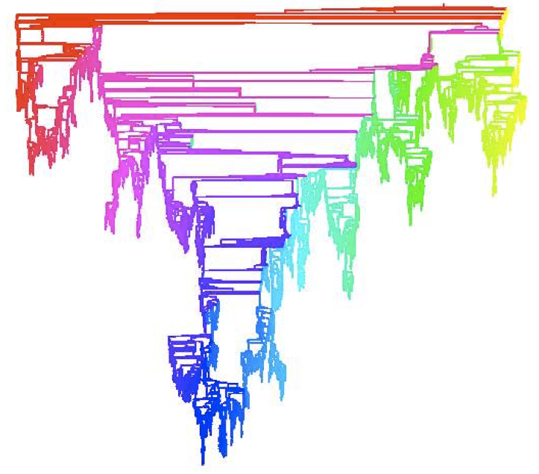
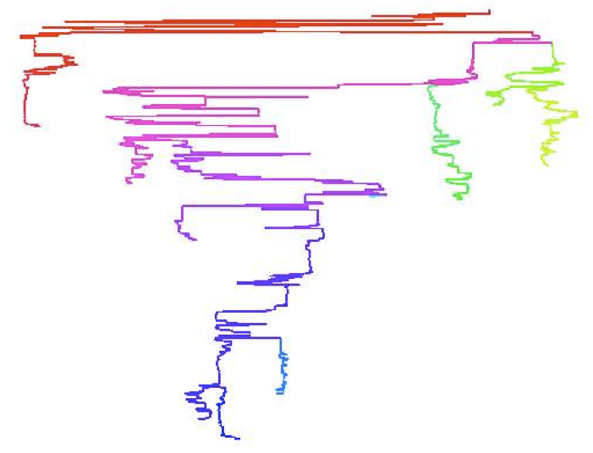
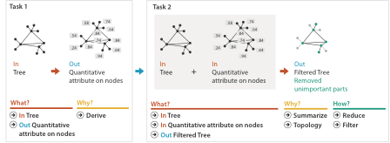
Analysis example: Derive one attribute
Strahler number
centrality metric for trees/networks
derived quantitative attribute
draw top 5K of 500K for good skeleton
[Using Strahler numbers for real time visual exploration of huge graphs. Auber. Proc. Intl. Conf. Computer Vision and Graphics, pp. 56–69, 2002.]
29

Slide 30
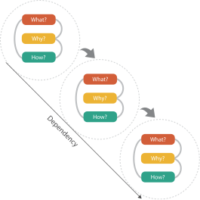
Chained sequences
output of one is input to next
express dependencies
separate means from ends
30

Slide 31
Further reading: Articles
Rethinking Visualization: A High-Level Taxonomy. InfoVis 2004, p 151-158, 2004.
31

